Slide 1
Solving Systems of Linear Equations by Substitution
Session 5
Practice Test – Sept 13
LT # 2 – Sept 15

Slide 2
Objectives
Choose the appropriate variable to solve for in a given system of equations.
Solve systems of linear equations by the substitution method.

Slide 3
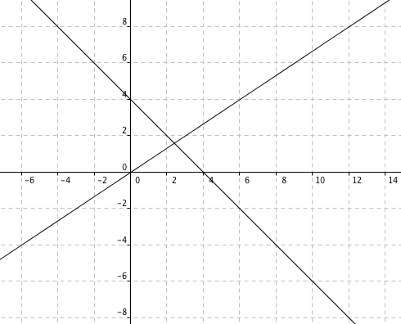
RECALL: Solve by graphing.
Identifying the point of intersection may produce inaccurate results.

Slide 4
SUBSTITUTION
Replacing one variable so that there is only one variable to solve for instead of two.

Slide 5
(1)
(2)
2x – 5(x + 7) = 4
What variable is isolated on one side of the equation?
Substitute x + 7 in (1).

Slide 6
2x – 5(x + 7) = 4
2x – 5x – 35 = 4
-3x = 4 + 35
-3x = 39
x = -13
y = x + 7
= -13 + 7
= -6
(-13, -6)
How do we know if the values of x and y are correct?

Slide 7
2x – 5y = 4 (1)
y = x + 7 (2)
(-13, -6)
2(-13) -5(-6) = 4
-6 = -13 + 7
-26 + 30 = 4
-6 = -6
4 = 4
How do we know if the values of x and y are correct?

Slide 8
What variable has a coefficient or either 1 or -1. Rewrite each equation to isolate the variable.
If we make x the subject of the equations, will we get the same solution? Which way is it easier?

Slide 9
What variable has a coefficient or either 1 or -1. Rewrite each equation to isolate the variable.
If we make y the subject of the equations, will we get the same solution? Which way is it easier?

Slide 10
Which variable has the smallest integral coefficient? Isolate this variable on one side of the equation.

Slide 11
How to choose which variable to solve for
A variable is already isolated on one side of the equation.
ex. 2x – 5y = 4
y = x + 7
Notes:
Standard form

Slide 12
How to choose which variable to solve for
2. One of the variables has a coefficient of 1 or -1.
ex. 2x + 6y = 3
x – 4y = 2
Notes:
Standard form

Slide 13
How to choose which variable to solve for
3. Choose the variable with the smallest integer coefficient.
ex. 11x – 7y = 10
14x + 2y = 9
Notes:
Standard form

Slide 14
How to identify systems that have no solution and that have more than one solution

Slide 15
SYSTEMS THAT HAVE NO SOLUTION
(Inconsistent)
2x – 3y = 6
6x – 9y = 36
Notes:
Standard form

Slide 16
SYSTEMS THAT HAVE MORE THAN ONE SOLUTION
(Consistent, Dependent)
9x + 6y = 6
6x + 4y = 4
Notes:
Standard form

Slide 17
Seatwork
Exercise 5c # 1, a – e NSM Book 2 page 163

Slide 18
x + y = 7
x – y = 5
Notes:
Standard form

Slide 19
3x – y = 0
2x + y = 5
Notes:
Standard form

Slide 20
2x – 7y = 5
3x + y = -4
Notes:
Standard form

Slide 21
5x – y = 5
3x + 2y = 29
Notes:
Standard form

Slide 22
5x + 3y = 11
4x – y = 2
Notes:
Standard form

Slide 23
Homework
Exercise 5c page 163, number 1 f – j

Slide 24
For further understanding
http://www.youtube.com/watch?v=PIzV_NYkhUM&feature=relmfu
http://www.regentsprep.org/Regents/math/ALGEBRA/AE3/AlgSys.htm
http://teachers.henrico.k12.va.us/math/hcpsalgebra1/Documents/examviewweb/ev9-2.htm

